Slide 1


AlHakikaNews: Real-Time AI Fake News Detector
The project targets real-time fake news verification using advanced AI.
It combines cutting-edge models to fight misinformation effectively.
by raph Onbsp

Slide 2
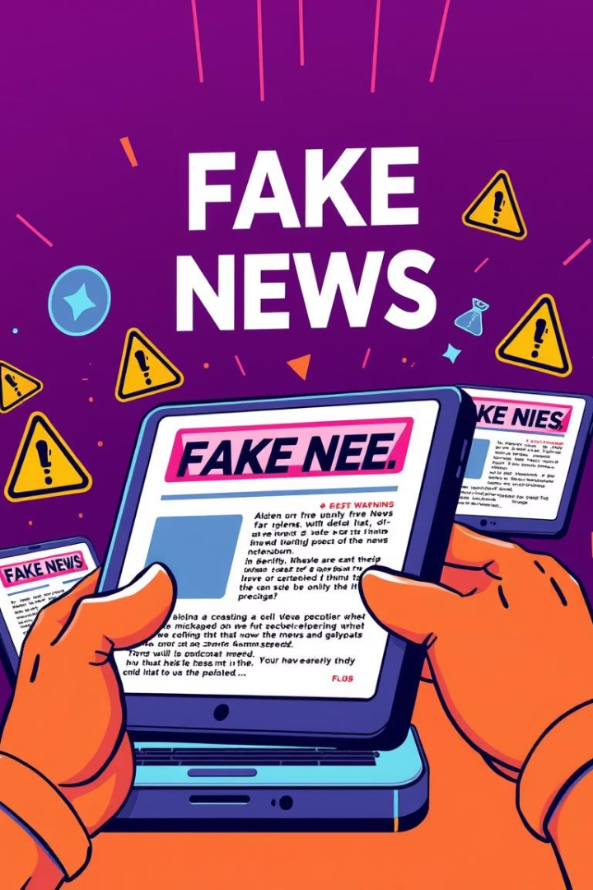
Challenges in DeepFake and Misinformation
Textual & Visual Misinformation
Detects false content in articles and images seamlessly.
Semantic Inconsistency
Identifies conflicting information within fake narratives.
Clickbait & Cross-Source Conflicts
Flags sensational headlines and contradictory sources.
Real-Time Detection
Enables instant verification for timely fact-checking.

Slide 3

AlHakikaNews: Hybrid AI Innovation
Ensemble Pipeline
Credibility Scores
Integrates GPT, Gemini, and classical models for accuracy.
Generates trust ratings for articles in real time.
Multi-Dimensional Analysis
User-Friendly Interface
Analyzes keywords, narratives, and visual reliability.
Accessible web platform ensuring transparency and ease.

Slide 4
Technical Architecture & Deployment
Core Technologies
System Features
Deep Learning & NLP
Ensemble output fusion
Transformers (GPT-4, Gemini)
Keyword tagging & confidence scores
Classical ML Models
Node.js frontend with cloud hosting
Future deployment on Moroccan cloud

Slide 5





Training Data & Preprocessing
Data Sources
~44,000 articles from Kaggle and regional news platforms.
Text Cleaning
Normalization, tokenization, stopwords removal, stemming.
Feature Engineering
TF-IDF and semantic embeddings for detailed analysis.
Labeling
Encoded article labels for supervised learning.

Slide 6
Performance Metrics & Fairness
Accuracy: 95.3%
Bias & Fairness checks enforced
Precision: 94.8%
Diverse languages and topics included
Recall: 95.9%
Special focus on African and MENA sources
F1 Score: 95.3%
False positives tested rigorously
Low-latency API (~500ms)

Slide 7





Real-World Application & Impact
Target Users
Input
Outputs
Journalists, educators, and the wider public.
Submit article text or links for review.
Credibility scores, flagged keywords, and explanations.
Impact
Scalable AI to combat misinformation globally.

